Slide 1
Developer skills and editor

Slide 2
Let’s make VS Code prettier
When using Visual Studio code, you probably want to make your code look pretty and organized so you can read it better.
First thing we can do is to make some changes to it
VS Code allows us to add Extensions (small programs that will make VS Code look and run better)
In our case we want to find and install extension named: Prettier
Remember – you don’t need any of the extensions, but it’s nice to have some, since they might be helpful

Slide 3
Snippets
Snippet is a short command that allows your Visual Studio to write code for you.
It is useful to use them for boring long code that you use all the time
For example – nice idea is to create snippet for console.log()
We can make snippet that will allow us the following:
Write cl and press enter
Your Visual Studio will write console.log() for you

Slide 4
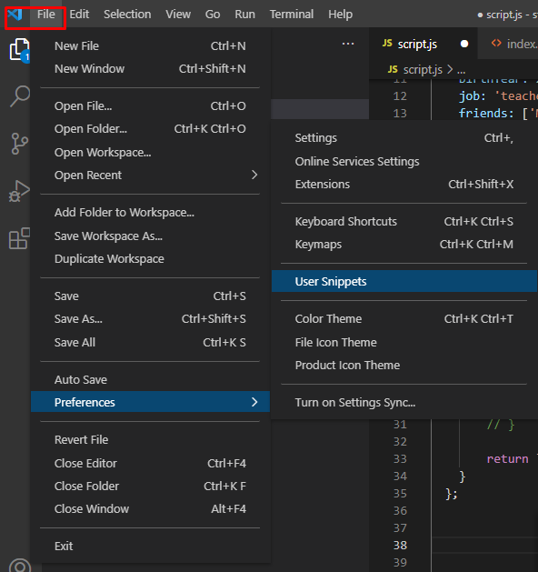
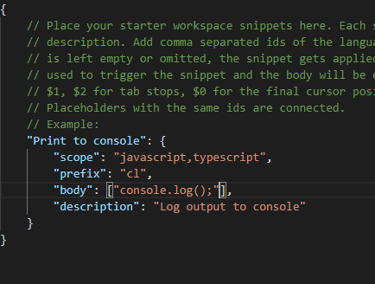
How to add Snippet

Slide 5
Check what are the best extensions
Check by yourself what are the best extensions to use
Read online why and in which situations you can use them
Then install them on you VS Code
And remember extensions can only help you a bit, they will not solve all your coding problems

Slide 6
Node.js for development
In previous few weeks we have been learning how to use javascript
How we used it:
Make change in the js file
Reload the browser
From now on, we can use one these two ways:
Install extension that will allow us to see changes of our code easier
Install node.js with npm package that will allow us to develop easier

Slide 7
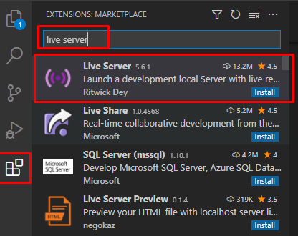
1st way - Adding extension
After installing this extension in the bottom we can click on go live
This way browser windows will be opened with localhost page (it will behave like code is running on some server)
When you make change to the code, you can just save file and changes will be visible on the webpage
You do not need to refresh

Slide 8
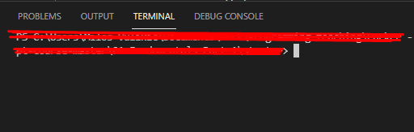
2nd way – Adding Node.js
Go to google and search for node.js
Download the node.js on your computer and install it
After installation you can check through your terminal if it is installed.
You should write command in the terminal: node –v
If number is shown, then node is successfully installed
Next step is to install npm package for live-server using terminal:
npm install live-server –g
(npm – node package manager helps downloading tools for your node.js)
After installing live-server, you just need to run it using terminal: live-server

Slide 9
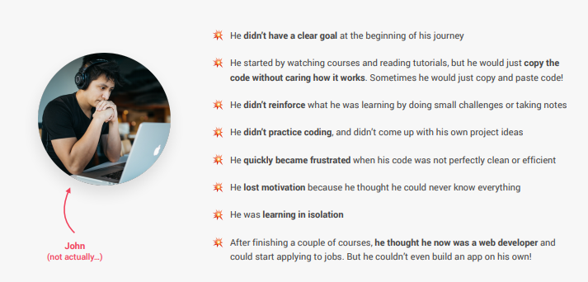
How NOT to learn coding

Slide 10
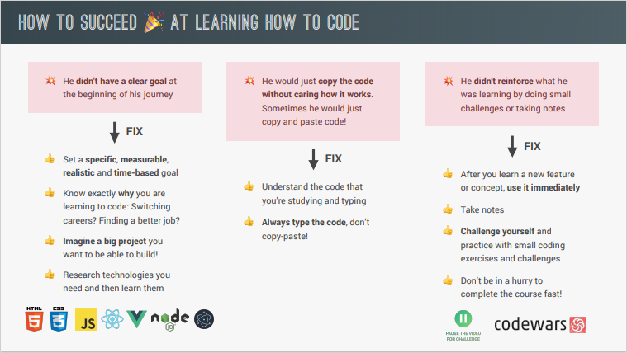
How to learn coding – part 1

Slide 11
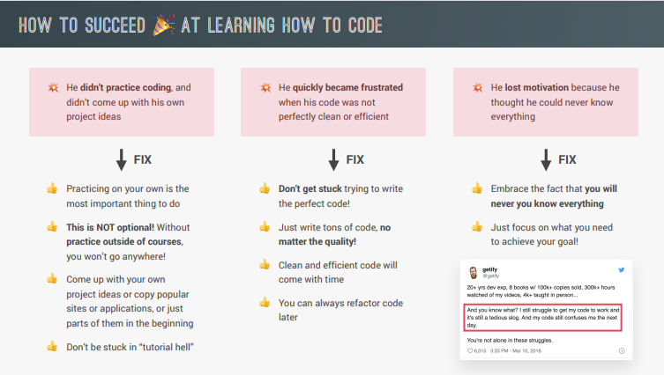
How to learn coding – part 2

Slide 12
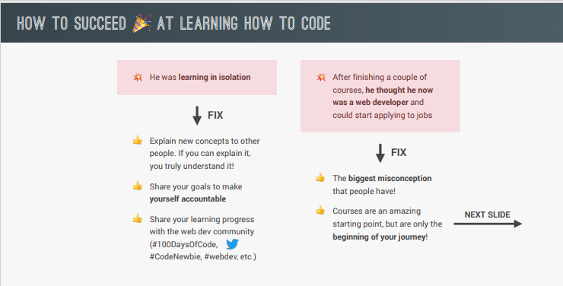
How to learn coding – part 3

Slide 13
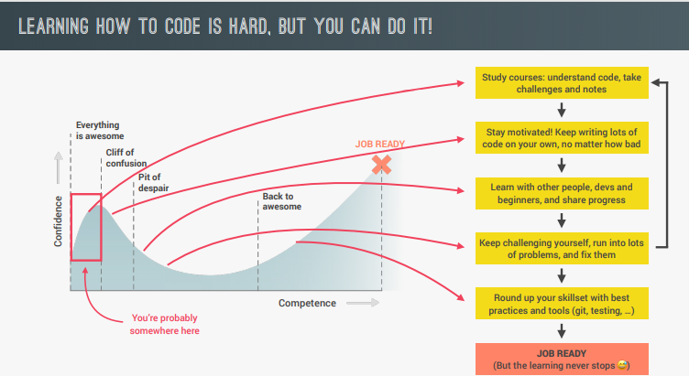
How to learn coding – part 4

Slide 14
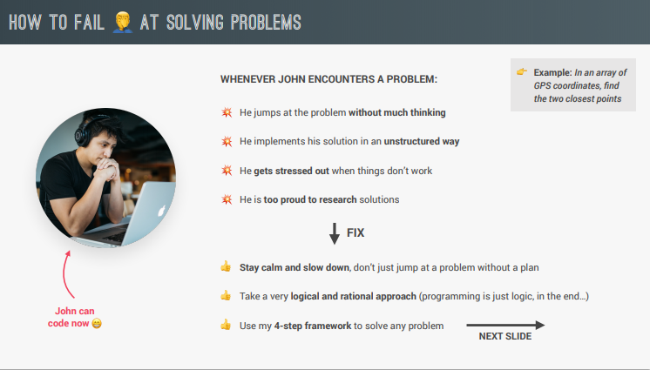
How NOT to solve a problem

Slide 15
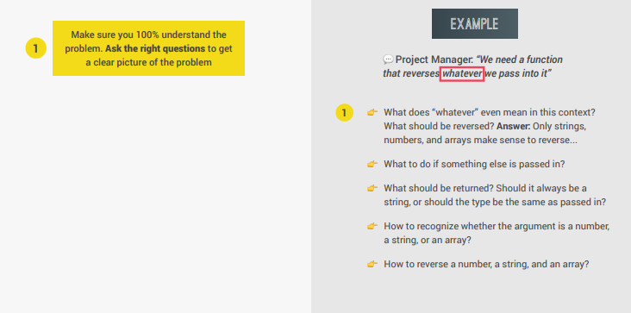
How to solve a problem - 1

Slide 16
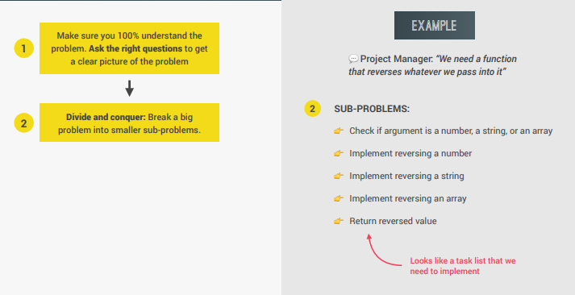
How to solve a problem - 2

Slide 17
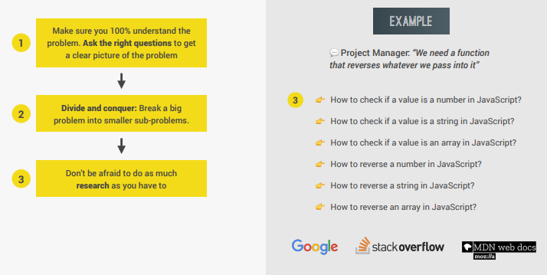
How to solve a problem - 3

Slide 18
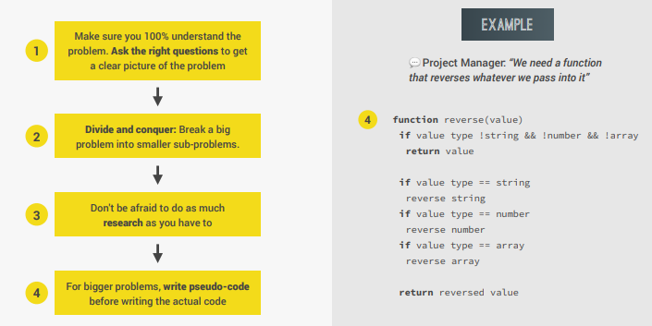
How to solve a problem - 4

Slide 19
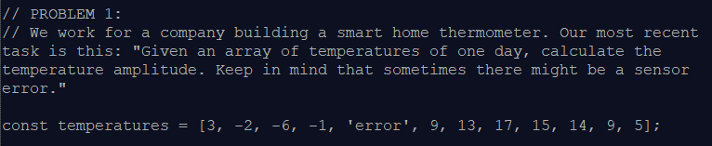
Solving real problems

Slide 20
1 - Understanding the problem
What is temp amplitude?
Answer: difference between highest and lowest temp
How to compute max and min temperatures?
What's a sensor error?
And what to do if error happens?

Slide 21
2 - Breaking up into sub-problems
How to ignore errors?
Find max value in temp array
Find min value in temp array
Subtract min from max (amplitude) and return it

Slide 22
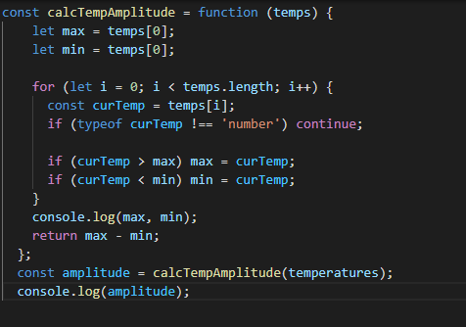
How the code might look like

Slide 23
Problem 2
Now the steps to solve the problem:
1) Understanding the problem
With 2 arrays, should we implement functionality twice?
NO! Just merge two arrays
2) Breaking up into sub-problems
Merge 2 arrays
We will probably need to check how to do this online: Google, StackOverflow, MDN or other websites… (array concat)

Slide 24
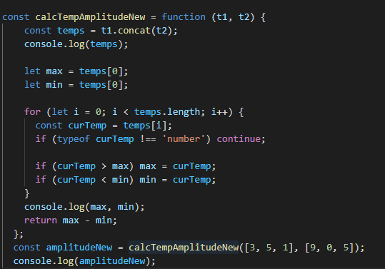
Problem 2 possible solution

Slide 25
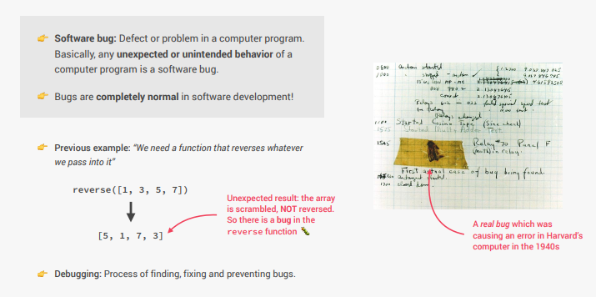
Debugging

Slide 26
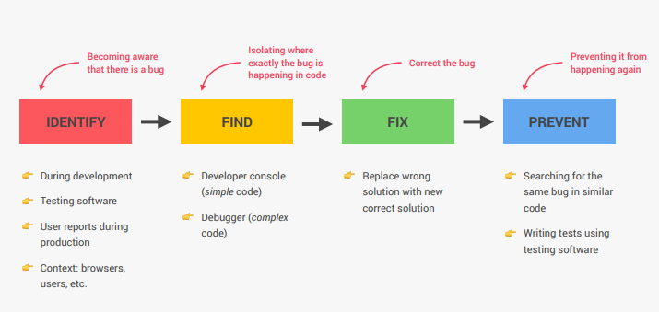
Debugging

Slide 27
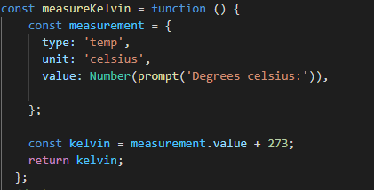
Example of debugging
Let’s make the tempearature calculation similar to before just in Kelvins.
273 K = 0 C
274 K = 1 C
Etc…
Let’s start with this:

Slide 28

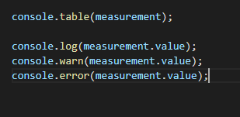
Steps
A) identify the problem
B) Find where is the problem
C) Fix the problem
Remember to use developer tools with breakpoints

Slide 29
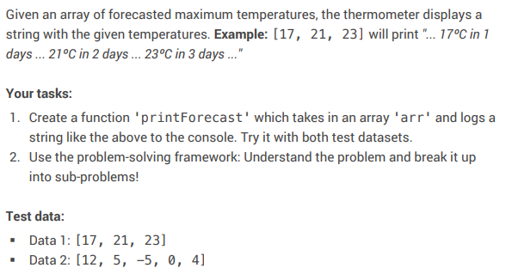
Homework (or Coding challenge)

